Slide 1



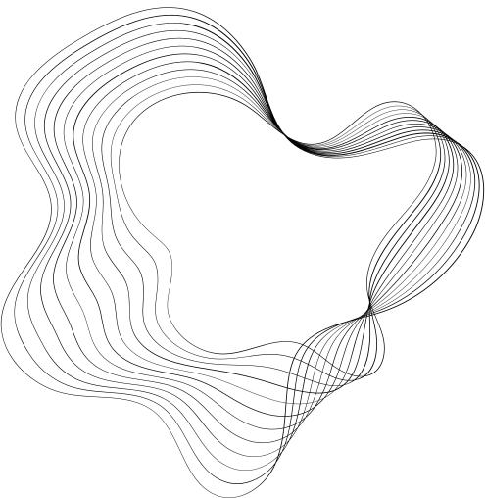
EDS PROJECT ON:-
Exploring the Cars DataSEt
Guided By: S.P Kale(MITAOE)
Presented By:
Hiten Shah (202201040140)
Pradip Koli (202201090035)
Akash Mandavkar (202201050008)
FY B-tech, MITAOE

Slide 2
Introduction
In this Python coding project, we will explore a "Cars Dataset" that contains a wealth of information about various car models. This dataset will serve as the foundation for our analysis and decision-making process. By working with this dataset, we will be able to extract meaningful insights and develop predictive models to help us make informed choices when it comes to selecting a car.
The Cars Dataset provides a wide range of attributes for each car model, including features like make, model, year, price, km driven, fuel type, number of owners, and more. By utilizing Python libraries such as pandas, numpy, and scikit-learn, we can effectively explore, clean, analyze, and visualize this dataset to gain valuable insights.

Slide 3

Motivation
Assist individuals in making informed car-buying decisions by analyzing and comparing car attributes.
Develop predictive models to accurately predict car prices based on their features.
Provide insights into pricing dynamics for car dealerships, manufacturers, and individuals.
Enhance Python programming skills in data analysis, cleaning, exploration, visualization, and machine learning modeling.

Slide 4
Details of Dataset
Name :- Cars Dataset
Number of Features :- 8
Number of records :- 4341

Slide 5
Data Manipulation
Loading data from different file formats or databases.
Exploring and inspecting the data.
Cleaning and handling missing values, duplicates, and incorrect data.
Selecting, filtering, and reordering data.
Aggregating and summarizing data.
Reshaping and transforming data.
Using libraries like pandas, numpy, and scikit-learn for efficient data manipulation operations.

Slide 6
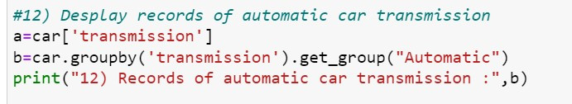
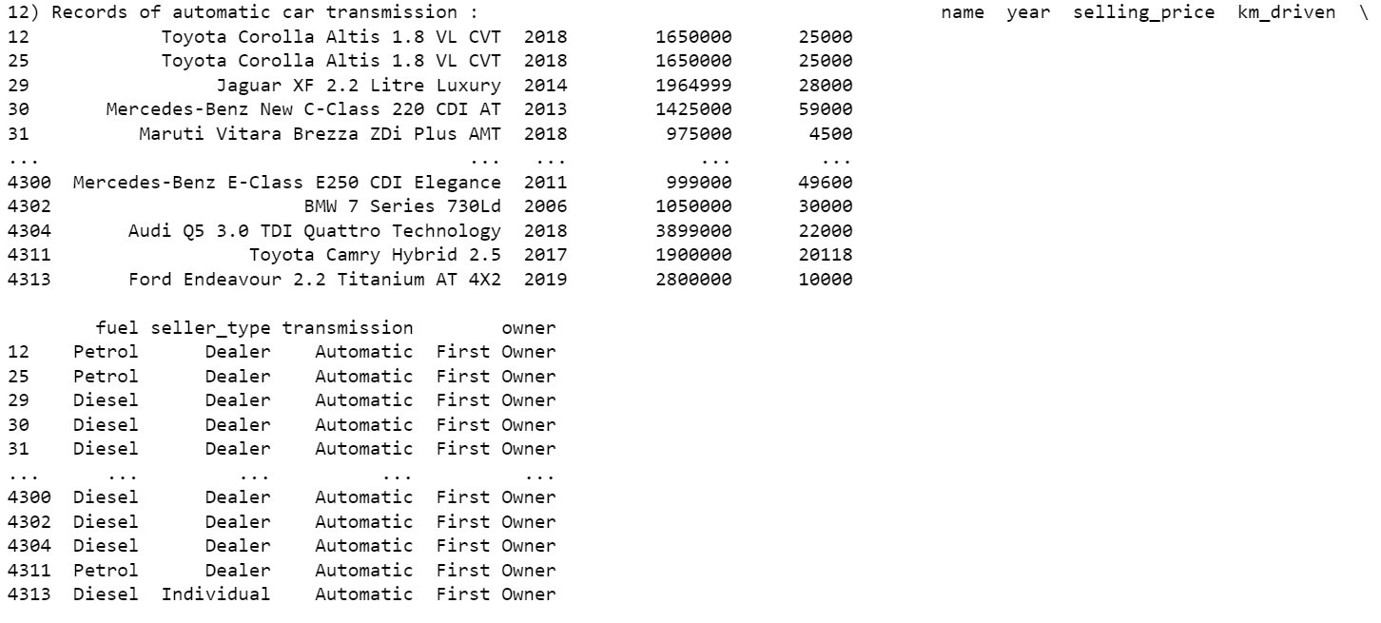

Slide 7
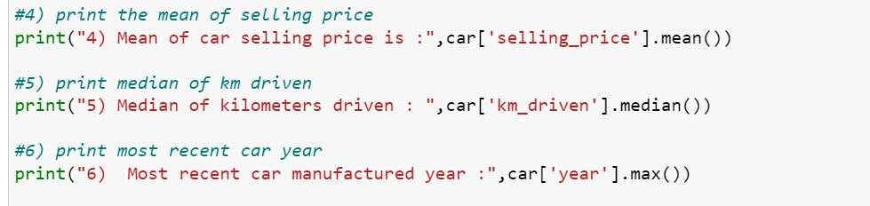

OUTPUT

Slide 8
Data Visualization
Using libraries like Matplotlib, Seaborn, and Plotly.
Creating various types of plots, such as line plots, bar charts, scatter plots, and histograms.
Customizing visual elements like colors, labels, titles, and legends.
Creating interactive visualizations with zooming, panning, and hover features.
Exporting visualizations to different file formats.

Slide 9
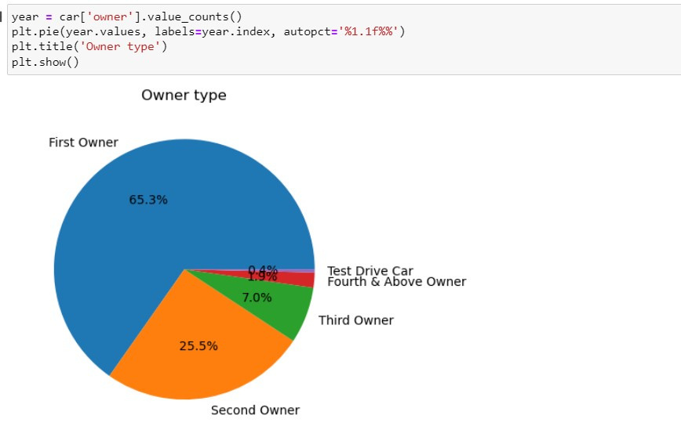
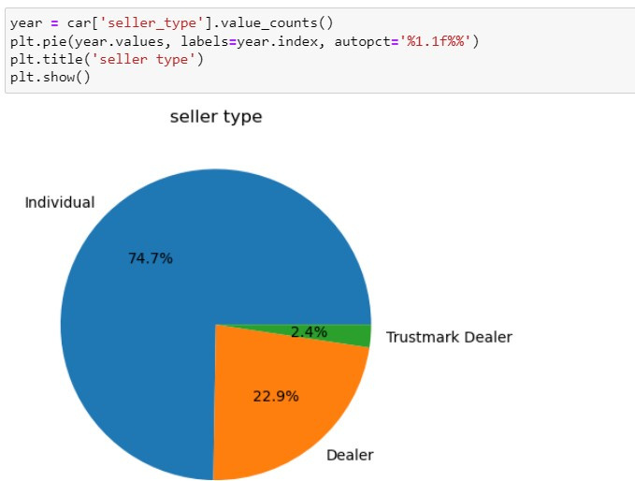
OUTPUT

Slide 10
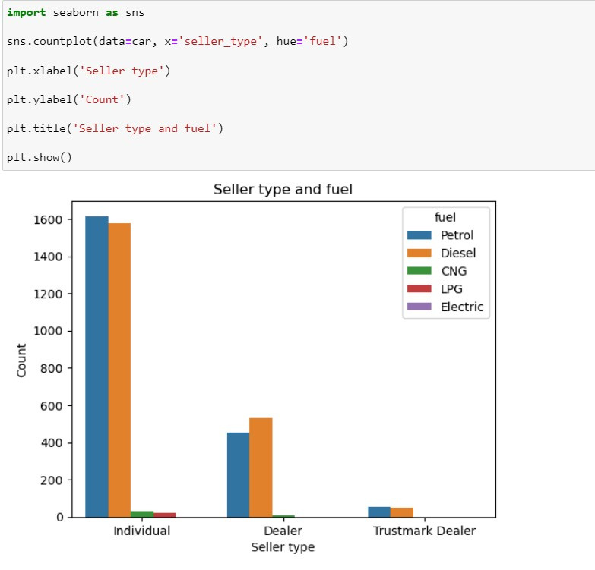
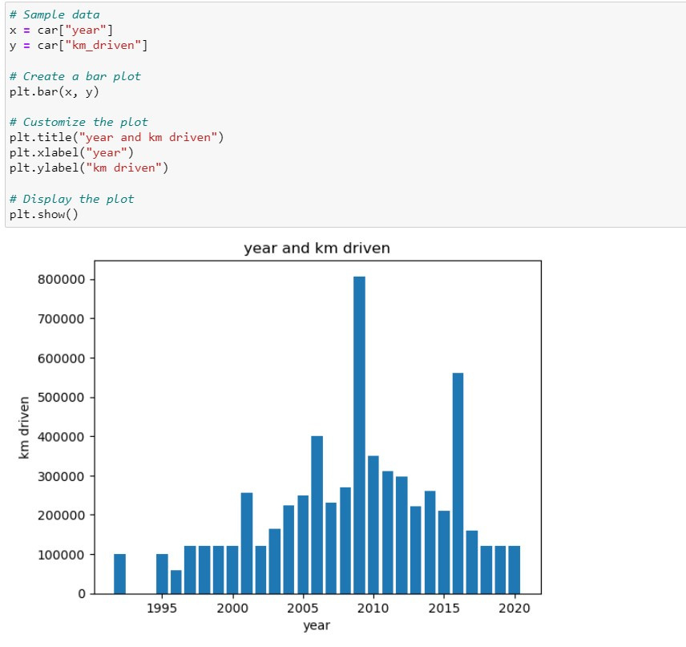

Slide 11
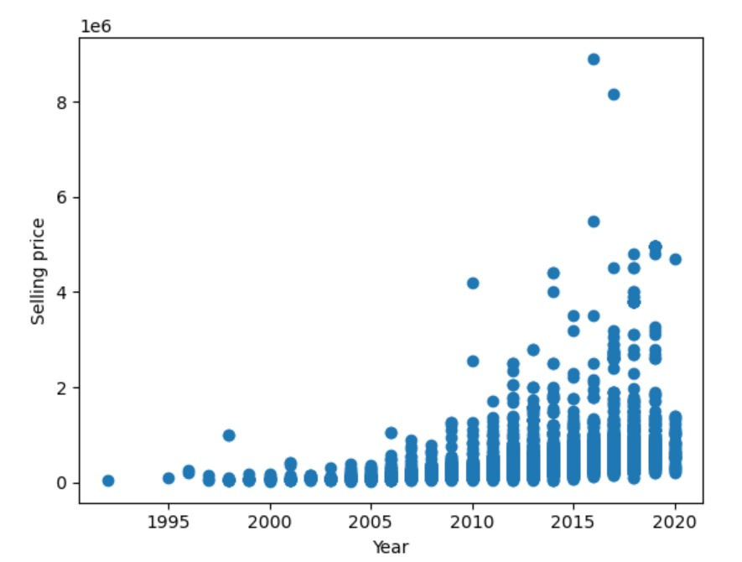
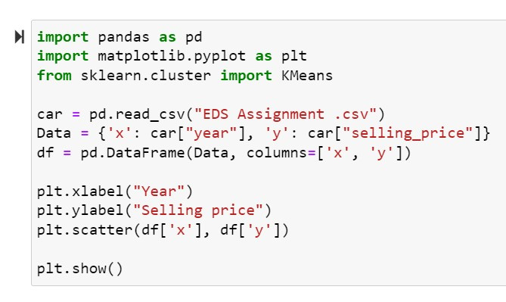
Predictive Technique (KMeans)

Slide 12
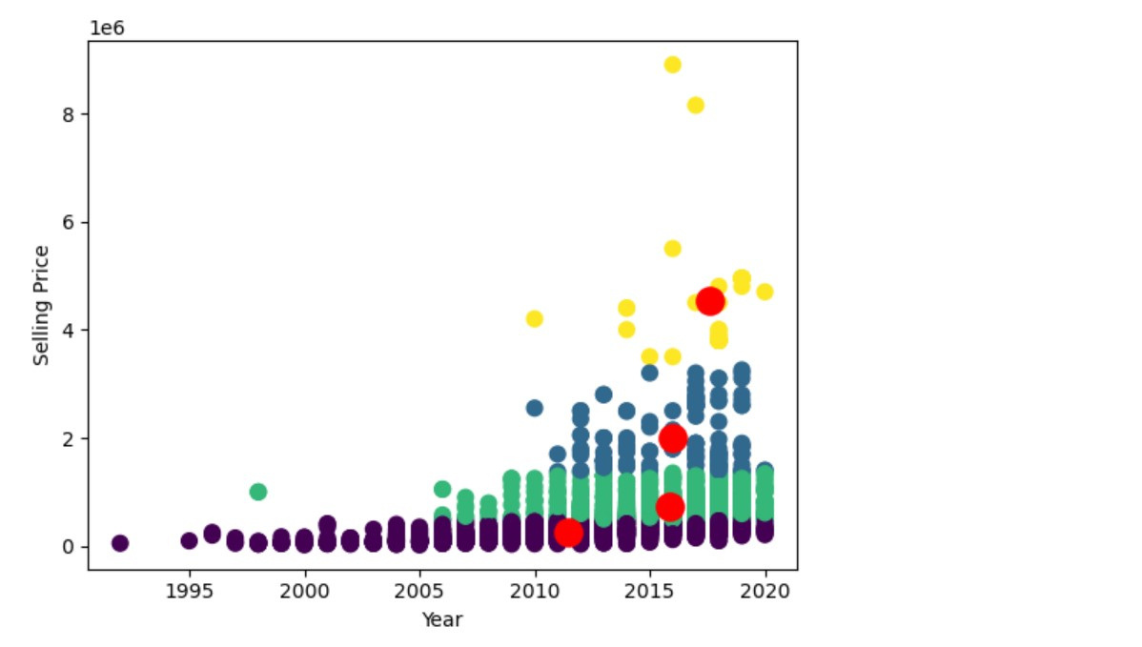
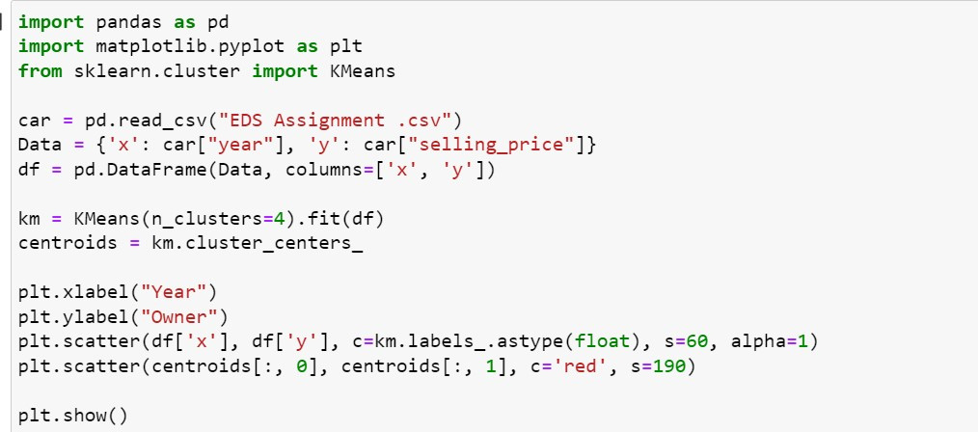
Output

Slide 13
Application
By cleaning, filtering, and transforming the dataset, you can gain a deeper understanding of the data.
Contemplating the Cars dataset we got to uncover patterns and relations between variables.
Plots such as histograms, scatter plots, pie and bar charts can provide visual representations.
After performing data manipulation and contemplating the data the clusters formed using KMeans, the resulting clusters can serve as new features for predictive modeling.
These cluster labels can be used as input features to build a classification model to predict several other factors which act while choosing a car.

Slide 14
Conclusion
In Summary, this analysis of the dataset has provided valuable insights regarding the model of the car, year of its production.
We discovered significant correlations between different variables such as Selling price, Km driven, Transmission type, Number of owners, Fuel type and Seller type.
Through data cleaning, preprocessing, visualization, and modeling, we were able to extract meaningful information.

Slide 15


THANK YOU!

